Slide 1

IOT Analysis report
Visualize and Analyze Energy Data

Slide 2
agenda
Visualizations Analysis
Time Series Analysis
Forecast() time series (linear regression)
Decompose() time series
Holtwinters() simple exponential smoothing
Five business recommendations
Lessons Learned

Slide 3
Visualizations analysis

Slide 4
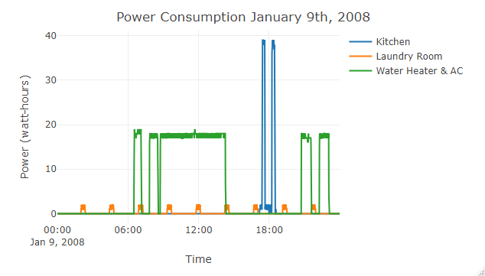
Single day 01/09/2008 Plot sub-meter 1, 2 and 3 – 1 minute frequency
Notes:
## Plot sub-meter 1, 2 and 3 with title, legend and labels - All observations plot_ly(houseDay, x = ~houseDay$DateTime, y = ~houseDay$Sub_metering_1, name = 'Kitchen', type = 'scatter', mode = 'lines') %>% add_trace(y = ~houseDay$Sub_metering_2, name = 'Laundry Room', mode = 'lines') %>% add_trace(y = ~houseDay$Sub_metering_3, name = 'Water Heater & AC', mode = 'lines') %>% layout(title = "Power Consumption January 9th, 2008", xaxis = list(title = "Time"), yaxis = list (title = "Power (watt-hours)"))

Slide 5
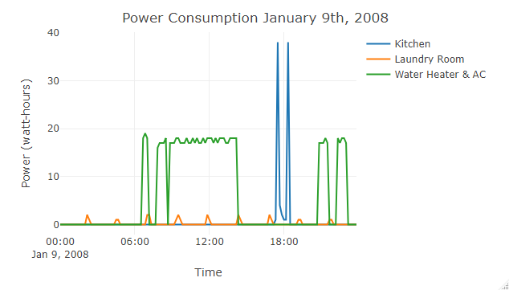
PLOT Subset the 9th day of January 2008 - 10 Minute frequency
Notes:
## Subset the 9th day of January 2008 - 10 Minute frequency houseDay10 <- filter(yourData, year == 2008 & month == 1 & day == 9 & (minute == 0 | minute == 10 | minute == 20 | minute == 30 | minute == 40 | minute == 50))
## Plot sub-meter 1, 2 and 3 with title, legend and labels - 10 Minute frequency
plot_ly(houseDay10, x = ~houseDay10$DateTime, y = ~houseDay10$Sub_metering_1, name = 'Kitchen', type = 'scatter', mode = 'lines') %>% add_trace(y = ~houseDay10$Sub_metering_2, name = 'Laundry Room', mode = 'lines') %>% add_trace(y = ~houseDay10$Sub_metering_3, name = 'Water Heater & AC', mode = 'lines') %>% layout(title = "Power Consumption January 9th, 2008", xaxis = list(title = "Time"), yaxis = list (title = "Power (watt-hours)"))

Slide 6
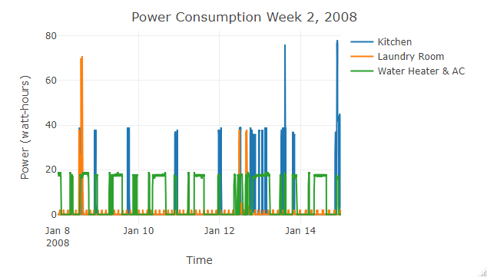
PLOTly Subset week 2 2008 – 1 minute frequency

Slide 7
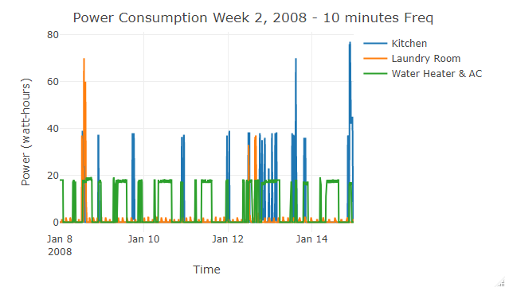
PLOTly Subset week 2 2008 – 10 minute frequency
Notes:
houseweek10 <- filter(newDF, year == 2008 & week == 2 & (minute == 0 | minute == 10 | minute == 20 | minute == 30 | minute == 40 | minute == 50))
plot_ly(houseweek10, x = ~houseweek10$DateTime, y = ~houseweek10$Sub_metering_1, name = 'Kitchen', type = 'scatter', mode = 'lines') %>% add_trace(y = ~houseweek10$Sub_metering_2, name = 'Laundry Room', mode = 'lines') %>%
add_trace(y = ~houseweek10$Sub_metering_3, name = 'Water Heater & AC', mode = 'lines') %>%
layout(title = "Power Consumption Week 2, 2008 - 10 minutes Freq", + xaxis = list(title = "Time"),
yaxis = list (title = "Power (watt-hours)"))

Slide 8
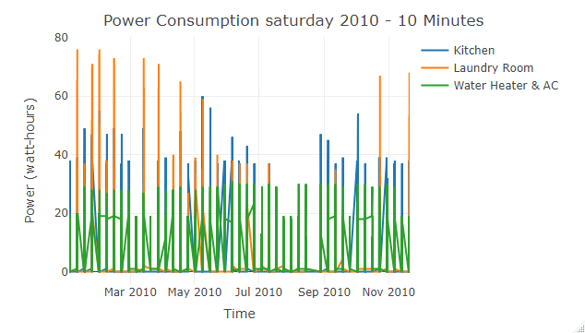
Plotly Saturdays 2010 – 10 minutes freq

Slide 9
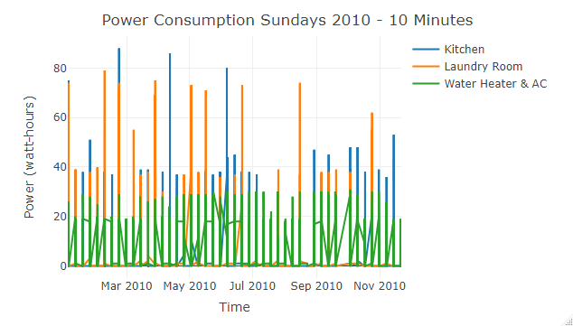
Plotly Sundays 2010 – 10 minutes freq

Slide 10
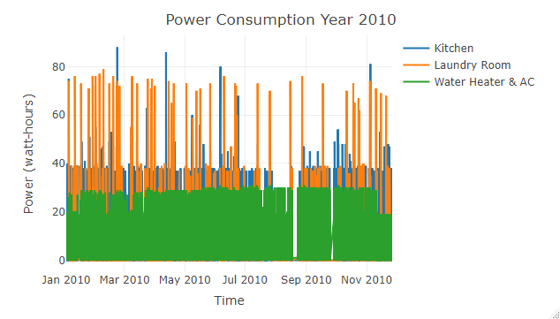
Plotly year 2010 – 10 minute freq

Slide 11
Time series analysis

Slide 12
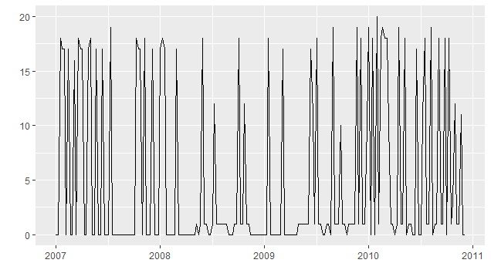
sub-meter 3 with a frequency of 52 (weekly) per year (07, 08 & 09)
Notes:
## Subset to one observation per week on Mondays at 8:00pm for 2007, 2008 and 2009 house070809weekly <- filter(yourData, weekDay == 2 & hour == 20 & minute == 1)
## Create TS object with SubMeter3 tsSM3_070809weekly <- ts(house070809weekly$Sub_metering_3, frequency=52, start=c(2007,1))
## Plot sub-meter 3 with autoplot (you may need to install these packages) libarary(ggplot2) libarary(ggfortify) autoplot(tsSM3_070809weekly)

Slide 13
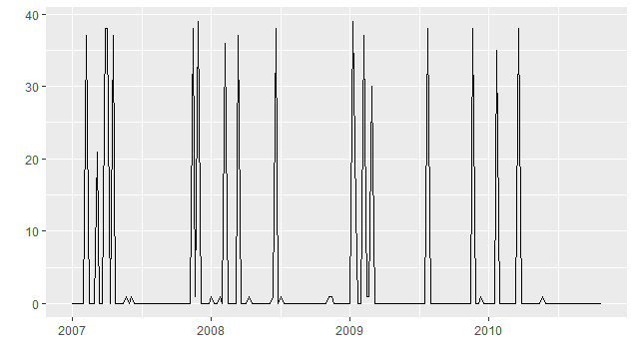
sub-meter 1 weekly years (07, 08 & 09) weekday (Sunday) hour (20)
Notes:
house070809Sunday <- filter(newDF, weekday == 'Sunday' & hour == 20 & minute == 1)
tsSM1_070809Sunday <- ts(house070809Sunday$Sub_metering_1, frequency = 52, start = c(2007, 1))
fitSM1sunday <- tslm(tsSM1_070809Sunday ~ trend + season)
forecastfitSM1sunday <- forecast(fitSM1sunday, h=52)
plot(forecastfitSM1sunday)

Slide 14
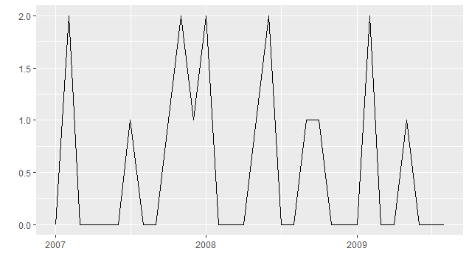
sub-meter 2 monthly Years (07, 08 & 09) Months(6, 7, 8 & 9) day (2) Hours (10 & 20)
Notes:
house070809summer <- filter(newDF, between(month,6,9) & day == 2 & (hour == 10 | hour == 20) & minute ==0) >
View(house070809summer)
tsSM2070809summer <- ts(house070809summer$Sub_metering_2, frequency = 12, start = c(2007, 1))
autoplot(tsSM2070809summer)
fitSM2070809summer <- tslm(tsSM2070809summer ~ trend + season )
plot(forecastfitsm2_070809summer)
forecastfitsm2_070809summer <- forecast(fitSM2070809summer, h=24)
plot(forecastfitsm2_070809summer)

Slide 15
Forcasting time series (linear regression)

Slide 16
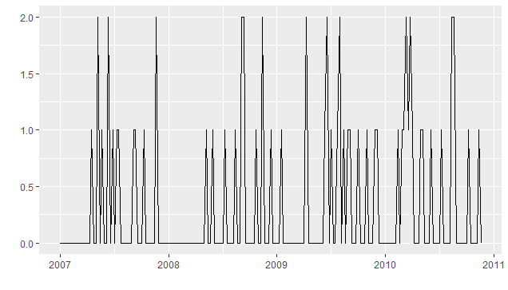
forecast for sub-meter 3. Forecast ahead 20 time periods
Notes:
fitSM3 <- tslm(tsSM3_070809weekly ~ trend + season)
summary(fitSM3)
forecastfitSM3 <- forecast(fitSM3, h=20)

Slide 17
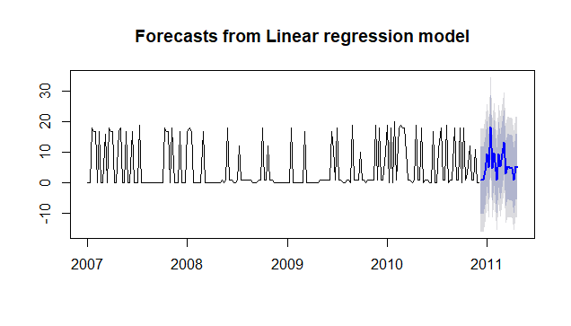
Plot the forecast for sub-meter 3.
Notes:
plot(forecastfitSM3)

Slide 18
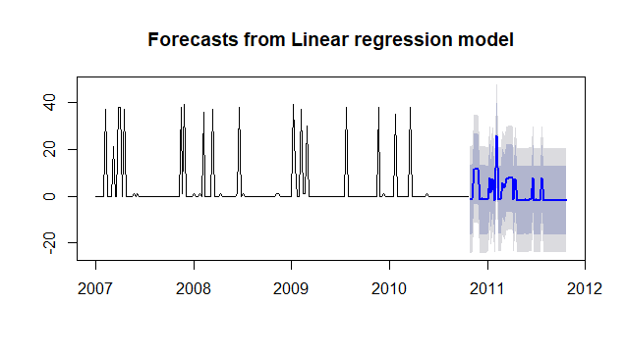
Forecast sub-meter 1 weekly years (07, 08 & 09) weekday (Sunday) hour (20)
Notes:
house070809Sunday <- filter(newDF, weekday == 'Sunday' & hour == 20 & minute == 1)
tsSM1_070809Sunday <- ts(house070809Sunday$Sub_metering_1, frequency = 52, start = c(2007, 1))
fitSM1sunday <- tslm(tsSM1_070809Sunday ~ trend + season)
plot(forecastfitSM1sunday)
forecastfitSM1sunday <- forecast(fitSM1sunday, h=52)

Slide 19
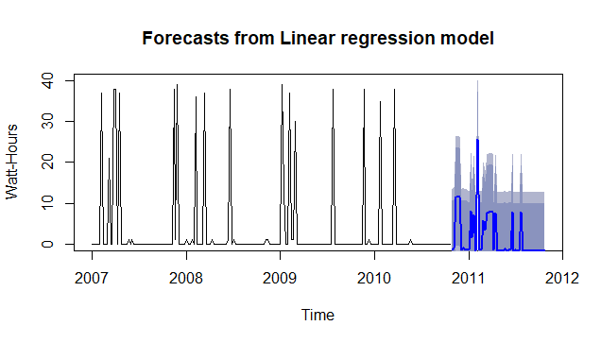
Forecast sub-meter 1 weekly years (07, 08 & 09) weekday (Sunday) hour (20) + confidence
Notes:
forecastfitSM1sundayC <- forecast(fitSM1sunday, h=52, level=c(70,80))
plot(forecastfitSM1sundayC, ylim = c(0, 40), ylab= "Watt-Hours", xlab="Time")

Slide 20
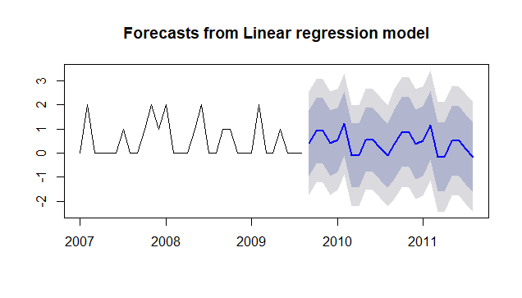
sub-meter 2 monthly Years (07, 08 & 09) Months(6, 7, 8 & 9) day (2) Hours (10 & 20)
Notes:
house070809summer <- filter(newDF, between(month,6,9) & day == 2 & (hour == 10 | hour == 20) & minute ==0) >
View(house070809summer)
tsSM2070809summer <- ts(house070809summer$Sub_metering_2, frequency = 12, start = c(2007, 1))
autoplot(tsSM2070809summer)
fitSM2070809summer <- tslm(tsSM2070809summer ~ trend + season )
plot(forecastfitsm2_070809summer)
forecastfitsm2_070809summer <- forecast(fitSM2070809summer, h=24)
plot(forecastfitsm2_070809summer)

Slide 21
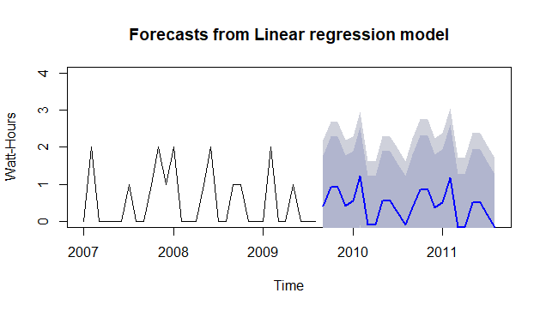
sub-meter 2 monthly Years (07, 08 & 09) Months(6, 7, 8 & 9) day (2) Hours (10 & 20) + confidence
Notes:
forecastfitSM2_070809summerC <- forecast(fitSM2070809summer, h=24, level=c(80,90))
plot(forecastfitSM2_070809summerC, ylim = c(0, 4), ylab= "Watt-Hours", xlab="Time")

Slide 22
Forecast () comparaison
Sub-Meter 1 weekly 2007, 2008 & 2009 Sundays at 8pm
Residual standard error: 9.942 on 146 degrees of freedom
Multiple R-squared: 0.2996,
Adjusted R-squared: 0.05018
F-statistic: 1.201 on 52 and 146 DF, p-value: 0.1983
Sub-Meter 2 Monthly 2007, 2008 & 2009 Months 6, 7, 8 & 9 at 10am & 8pm
Residual standard error: 0.8039 on 19 degrees of freedom
Multiple R-squared: 0.3167,
Adjusted R-squared: -0.1148
F-statistic: 0.7339 on 12 and 19 DF, p-value: 0.7041
Notes:
Summary()
FitSM2070809summer
FitSM1070809weeklysunday

Slide 23
Decompose() time series

Slide 24
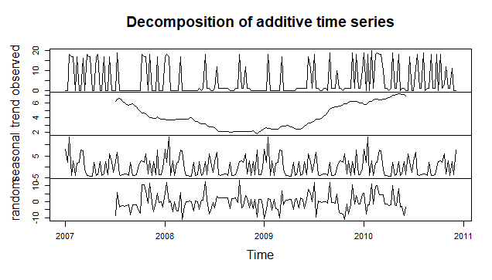
Decompose Sub-meter 3 into trend, seasonal and remainder
Notes:
components070809SM3weekly <- decompose(tsSM3_070809weekly) >
plot(components070809SM3weekly)
summary(components070809SM3weekly)

Slide 25
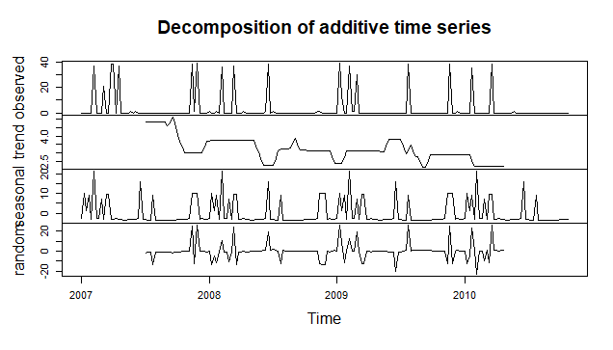
decomposed sub-meter 1 weekly years (07, 08 & 09) weekday (Sunday) hour (20)
Notes:
One comparison chart showing the summary statistics for the seasonal, trend and remainder components from each decomposed object:

Slide 26
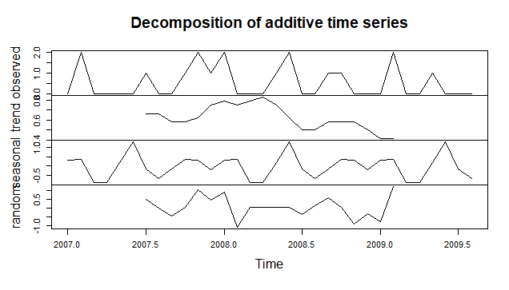
Decomposed sub-meter 2 monthly Years (07, 08 & 09) Months(6, 7, 8 & 9) day (2) Hours (10 & 20)
Notes:
One comparison chart showing the summary statistics for the seasonal, trend and remainder components from each decomposed object
summary(components070809SM2monthlysummer) Length Class Mode x 32 ts numeric seasonal 32 ts numeric trend 32 ts numeric random 32 ts numeric figure 12 -none- numeric type 1 -none- character

Slide 27
Decompose () comparaison
After reviewing the result plot of both Sub-meters 1 and 2, we can see that it shows certain trend and season effects on power usage, we can explain it over both the time periods in 2007, 2008 and 2009 chosen for the analysis :
The weekly Sundays as the owner might enjoy their rest day by doing some cooking in the kitchen and also Over Summers the weather gets hotter and with that it tend to increase the usage of the laundry room…

Slide 28
Holtwinters() simple exponential smoothing

Slide 29
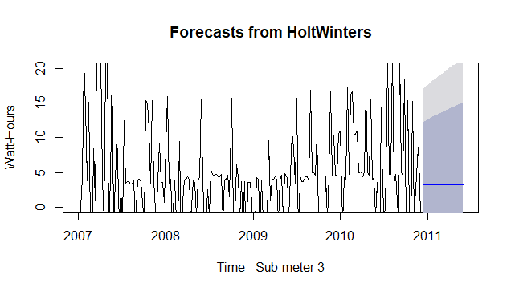
HoltWinters forecast & plot sub-meter 3
Notes:
## HoltWinters forecast & plot tsSM3_HW070809for <- forecast(tsSM3_HW070809, h=25) plot(tsSM3_HW070809for, ylim = c(0, 20), ylab= "Watt-Hours", xlab="Time - Sub-meter 3")

Slide 30
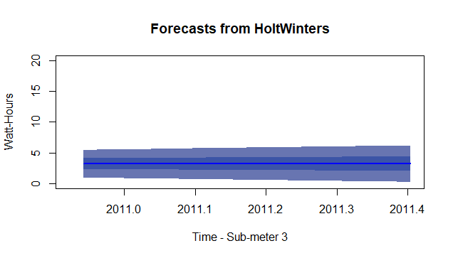
Forecast HoltWinters sub-meter 3 with diminished confidence levels
Notes:
tsSM3_HW070809forC <- forecast(tsSM3_HW070809, h=25, level=c(10,25))
plot(tsSM3_HW070809forC, ylim = c(0, 20), ylab= "Watt-Hours", xlab="Time - Sub-meter 3", start(2010))

Slide 31
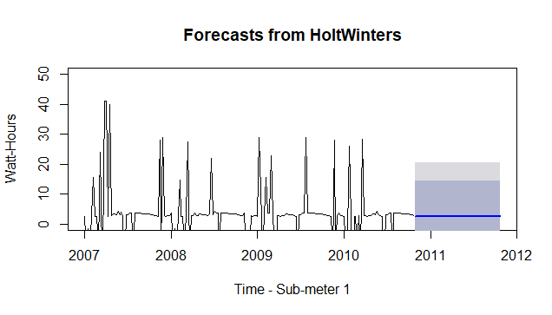
Holtwinters() forcast Sub-meter 1 weekly years (07, 08 & 09) weekday (Sunday) hour (20)
Notes:
tsSM1_070809SundayAdjusted <- tsSM1_070809Sunday - components070809SM1weeklysunday$seasonal
autoplot(tsSM1_070809SundayAdjusted)
plot(decompose(tsSM1_070809SundayAdjusted))
tsSM1_HW070809sunday <- HoltWinters(tsSM1_070809SundayAdjusted, beta=FALSE, gamma=FALSE)
plot(tsSM1_HW070809sunday, ylim = c(0, 50))
tsSM1_HW070809sundayfor <- forecast(tsSM1_HW070809sunday, h=52)
Plot(tsSM1_HW070809sundayfor , ylim = c(0, 50), ylab= "Watt-Hours", xlab="Time - Sub-meter 1")

Slide 32
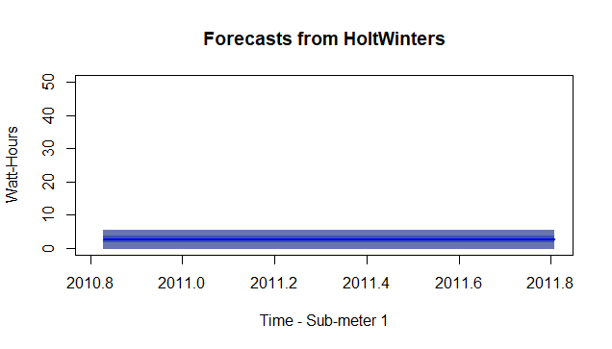
Holtwinters() forecast only Sub-meter 1 weekly years (07, 08 & 09) weekday (Sunday) hour (20)
Notes:
tsSM1_HW070809sundayC <- forecast(tsSM1_HW070809sunday, h=52, level=c(10,25))
plot( tsSM1_HW070809sundayC, ylim = c(0, 50), ylab= "Watt-Hours", xlab="Time - Sub-meter 1", start(2010))

Slide 33
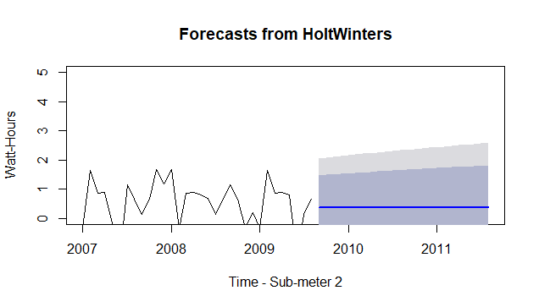
Holtwinters() forecast sub-meter 2 monthly Years (07, 08 & 09) Months(6, 7, 8 & 9) day (2) Hours (10 & 20)
Notes:
tsSM2070809summerAdjusted <- tsSM2070809summer - components070809SM2monthlysummer$seasonal
autoplot(tsSM2070809summerAdjusted)
plot(decompose(tsSM2070809summerAdjusted))
tsSM2_HW070809summer <- HoltWinters(tsSM2070809summerAdjusted, beta=FALSE, gamma=FALSE)
plot(tsSM2_HW070809summer, ylim = c(0, 5))
tsSM2_HW070809summerfor <- forecast(tsSM2_HW070809summer, h=24)
plot(tsSM2_HW070809summerfor , ylim = c(0, 20), ylab= "Watt-Hours", xlab="Time - Sub-meter 2")

Slide 34
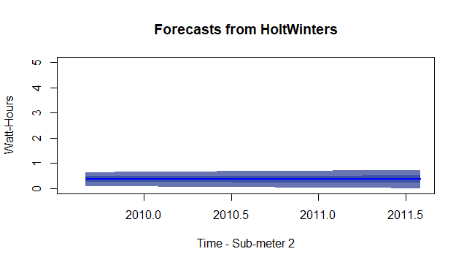
Holtwinters() forecast only sub-meter 2 monthly Years (07, 08 & 09) Months(6, 7, 8 & 9) day (2) Hours (10 & 20)
Notes:
tsSM2_HW070809summerC <- forecast(tsSM2_HW070809summer, h=24, level=c(10,25))
plot(tsSM2_HW070809summerC, ylim = c(0, 5), ylab= "Watt-Hours", xlab="Time - Sub-meter 2", start(2010))

Slide 35
Five business recommendations
Once again the Separate of appliances over more than 3 sub-meters can bring a huge difference perspective for what is related to your power consumption.
Scheduling the temperature desired according to the owner condition and location is very important as you program your thermostat weekly (weekdays as you are at work, and weekends as you might be hanging out at the house) and also by night meeting your sleeping.
Bring a new way to manage and control (ON/OFF) your power consumption from anywhere by using a Mobile application.
Having access to different visualizations and statistics (monthly, weekly…) and being instantly notified of any unusual power consumption can be beneficial to track your bills and also to detect any kind of problems in your installations like a water leak…
Do not neglect the outside environment temperature changes, Sceaux is very known for short summers, that are comfortable and for long winters that are very cold, this might be another way to save and adjust your power consumption appropriately for each season.
Notes:
Any useful correlations or predictions you can glean from the data. If none can be found or if the relationships are weak, suggest other types of data you believe might be needed to improve the analysis
A summary statement that addresses the goal of this project. Has the goal been met?
you can suggest based on your visualization and analysis of the power consumption data. Include justifications of your recommendations
Starting by Sub-Meter 3 I think we can make a big saving on the power usage of the Air conditionning, as In Sceaux, the summers are short, comfortable, and partly cloudy and the winters are long, very cold, windy, and mostly cloudy. Over the course of the year, the temperature typically varies from 35°F to 77°F and is rarely below 25°F or above 88°F.

Slide 36
Lessons learned
The importance of granularity and how to subset the Data Frame into time periods.
Explore more visualization techniques and how to apply it within different time of periods.
Develop different time series regression models and work with seasonal and non-seasonal forecasting.
I had a little difficulty to summarize the analysis of my plots as I wasn’t familiar with the industry at first but later on in the walkthrough of the course, I was able to understand the variation of power usage and consumption within a house.

